Slide 1
trustwise - #fintech
Swiss Blockchain Platform

Slide 2
Demo Time

Slide 3
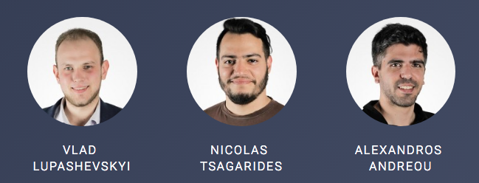
The Team

Slide 4
Architecture
On-chain
Off-chain
Smart Contract
Loaner
Lender
Vault Controller

Slide 5


BoC Integration
KYC & Legal Processes
Secured Loan Revolution with UNBROKABLE
Technology

Slide 6

Market Volume
$$fee\left(amount, time\right)=days∗0.01\%∗amount$$

Slide 7
Other Applications
Property renting industry
Courier industry
Other smart lock based industries

Slide 8
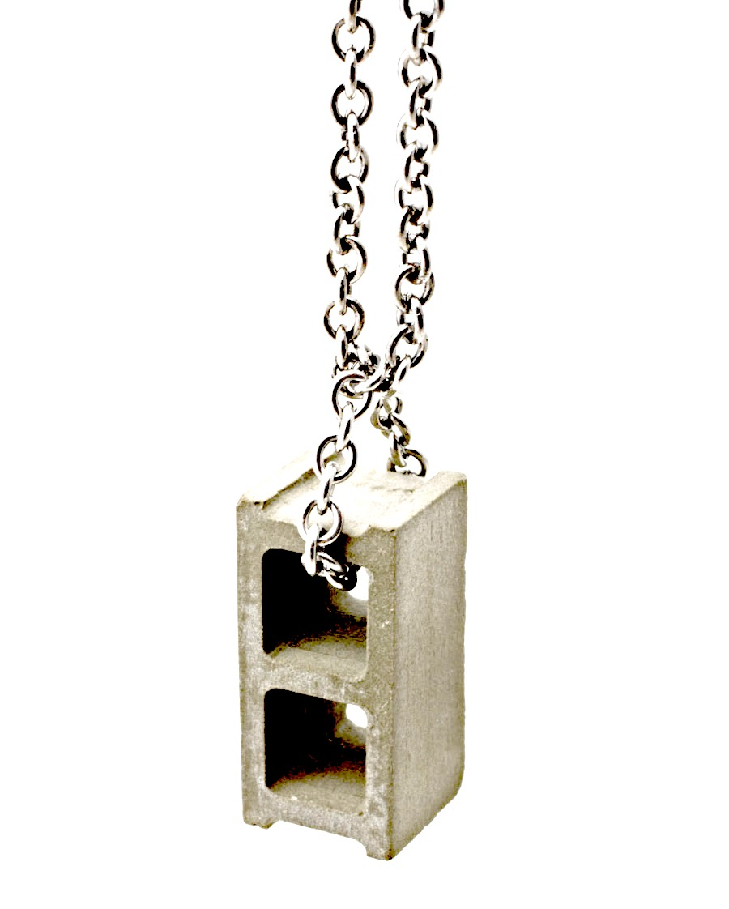
Thank you

